Slide 1
Traffic Grooming
Optical Communication Network
Dr L. Beygi.

Slide 2
Previously on this course
Learned how to find a route for a lightpath (Routing)
Learned how to deal with low SNR or corrupted signals in route (Regeneration of lightpath)
Learned how to assign wavelength to a lightpath (Wavelength Assignment)
Learned (or will learn) how to protect a lightpath from failures (Protection)
We are keep saying lightpath, but what is lightpath and how it’s created ?
Before answering this question, a story must be told

Slide 3
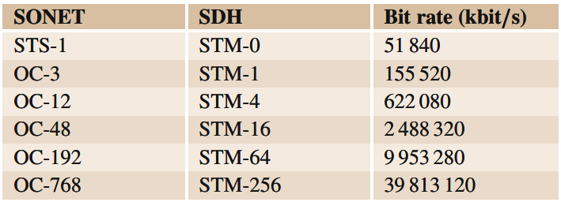
Story of rates and standards
In the 1970s, traffic carried over networks consisted primarily of 64 kb/s services including voice, FAX, and modem data
Initial lightwave systems started to emerge around 1975
Synchronous optical transport networks (SONET and SDH) began emerging in the mid-1980s

Slide 4
Story of rates and standards (cont.)
With the fact that the transmission rate of 50 Mb/s grew eventually to 40 Gb/s were much greater than the (initial) service rates of 64 kb/s enabled the birth of what has become known as the transport network
This split between transport network and service network gave telecom network operators planning independence between service network capacity and offerings and the transmission capacity they built into their networks.
One important feature of SONET/SDH was Virtual concatenation (VCAT), which enabled creating larger client containers by logically gluing together multiple smaller containers to form a container that was right sized for a given client.
SONET/SDH provided standardized mapping of client signals, enhanced performance monitoring at multiple layers, comprehensive fault detection and isolation.
A evolutionary step in optical networking occurred with the introduction of wavelength division multiplexing (WDM).

Slide 5
Story of rates and standards (cont.)
Deploying WDM systems has allowed carriers to tap enormous capacity by carrying multiple wavelengths over a single fiber. For carriers, this means significant cost savings compared to the cost of deploying single-channel networks, or of overlaying multiple networks for each service offering.
As transition to WDM architectures occurred, it became painfully obvious that early WDM implementations lacked many key features required to properly operate and maintain these optical networks.
With early WDM platforms many features, such as performance monitoring, fault detection and isolation, a standard multiplexing, were either missing or implemented in a proprietary fashion by each WDM equipment vendor.
These events led to Optical Transport Network (OTN) birth.

Slide 6
Optical Transport Network (OTN)
OTN were developed to add SONET-like performance monitoring, fault detection, communication channels, and multiplexing hierarchy to WDM wavelengths.
The primary benefits of OTN include:
Enhanced Operations, Administration and Maintenance (OAM) for wavelengths
Standard multiplexing hierarchy
End-to-end optical transport transparency of customer traffic
Multi-level path OAM

Slide 7
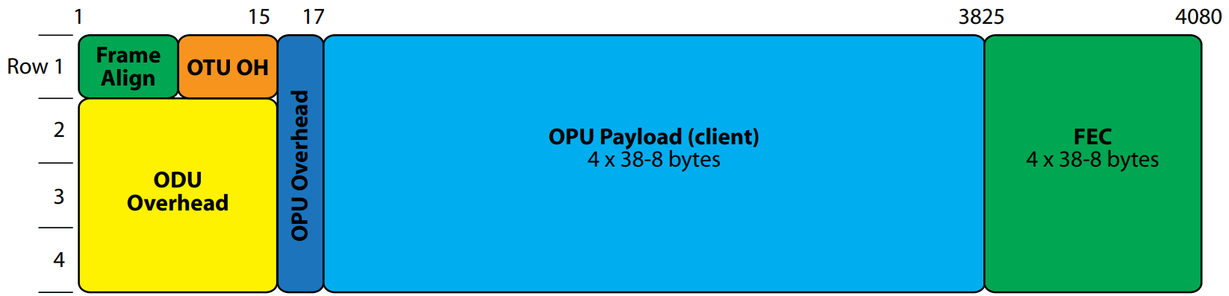
OTN Frame Structure
Adding OAM capabilities to WDM networks required creating a frame structure to “digitally wrap” or “encapsulate” the payload.
There are three overhead areas in an OTN frame: the Optical Payload Unit (OPU) overhead, the Optical Data Unit (ODU) overhead, and the Optical Transport Unit (OTU) overhead.

Slide 8
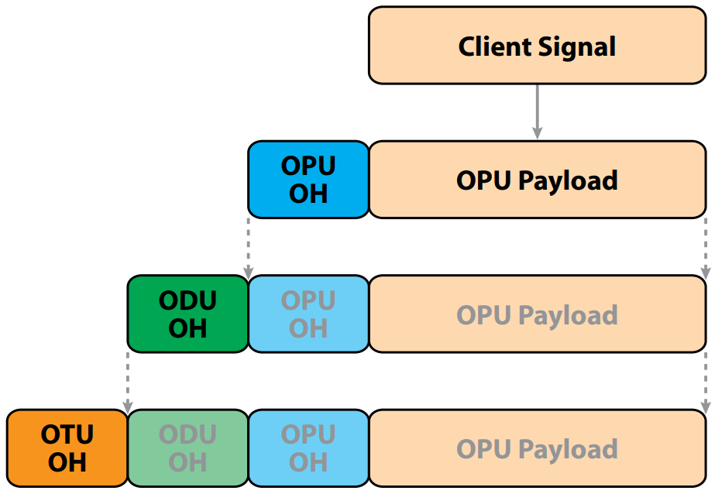
OTN Frame Structure (cont.)
A client signal is mapped into the OPU payload, with the OPU overhead providing information on the type of signal mapped into the payload and the mapping structure.
The ODU overhead adds optical path-level monitoring, alarm indication signals, automatic protection switching bytes, and data communications channels.
The OTU overhead adds bytes to provide optical section layer Performance Monitoring (PM), alarm indication.
The OTU represents a physical optical interface or port, such as an OTU2 (10 Gbps), OTU3 (40 Gbps) and OTU4 (100 Gbps)

Slide 9
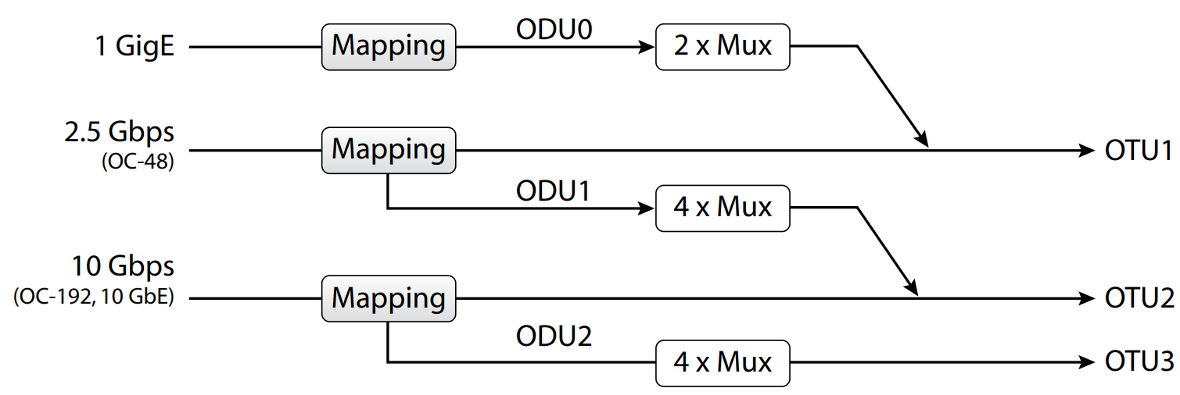
Standard Hierarchy in OTN

Slide 10
Beginning of everything
Above is a sample of Traffic Matrix
Along with Physical Topology, they are the main inputs of the planning process.

Slide 11
Subrate Traffic and Line Rate
Line Rate
Rate of traffic that can be carried in a single wavelength channel
Example of line rates: 40 Gb/s, 100 Gb/s, 200 Gb/s , …
Subrate traffic (sometimes referring as Service)
Actual traffic demands that backbone have to carry them
Could be in SDH/SONET or OTN standard
basically a lightpath is a collection of subrate traffics which stated by Traffic Matrix.

Slide 12
Big Question
How to map subrate traffics to lightpaths ?
Possible answers:
utilizes a full wavelength to carry a subrate demand, thereby wasting the remaining capacity of the wavelength
The preferred solution is to carry multiple subrate traffic demands in a single wavelength (known as end-to-end multiplexing)
subrate demands that have the same source and destination are bundled together to better fill a wavelength
The demands are then routed as a single unit from source to destination
While multiplexing improves the network efficiency, it may still be inefficient if the level of traffic between node pairs is small

Slide 13
Big Question (cont.)
A more effective technique is grooming, where traffic bundling occurs not only at the endpoints of the demands, but also at intermediate points.
Demands may ride together on the same wavelength even though the ultimate endpoints are not the same, providing opportunities for more efficient wavelength packing.

Slide 14
Everything good ?
While grooming is an effective means of transporting subrate traffic, it can also be costly.
Switches that perform grooming may be expensive and may present challenges in power consumption, heat dissipation, and physical space, which will only be exacerbated as the network traffic increases
For cost and architectural reasons, grooming switches may be deployed in only a subset of the network nodes.
Given a set of subrate demands, there typically is no single optimal design to groom the demands into lightpaths. For example, one design could favor minimizing cost at the expense of routing demands over very circuitous paths, whereas another design could place a greater emphasis on minimizing path length and reserving capacity for future subrate demands, …
Grooming problem in general is a NP-complete problem
There is no single heuristic grooming algorithm that always produces the “best” results.

Slide 15
End to end multiplexing
Traffic demands with the same source and destination are packed into lightpaths, is a simple means of grouping subrate traffic to better utilize network capacity
Once the subrate demands have been grouped into a lightpath, they can be treated as if they are a single demand
The multiplexing function is most commonly accomplished via a wavelength division multiplexing (WDM) transponder equipped with multiple client-side feeds. This is referred to as a multiplexing transponder, or simply, a muxponder.

Slide 16
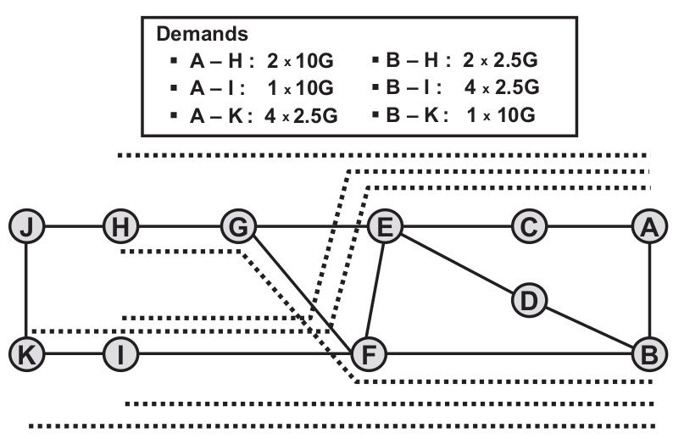
Example of End to end multiplexing
First Question to ask after seeing Traffic Matrix ??
the six wavelengths are 27 % full
if no multiplexing were used, such that each subrate demand is carried on a separate wavelength, the average wavelength fill rate would be roughly 12 %.

Slide 17
QoS consideration
When multiplexing traffic together, it is important to ensure that the individual subrate demands are compatible:
Some demands may have a requirement that they not be routed on certain links in the network
Some demands require protection whereas others do not
Future traffic consideration (Day N traffic)

Slide 18
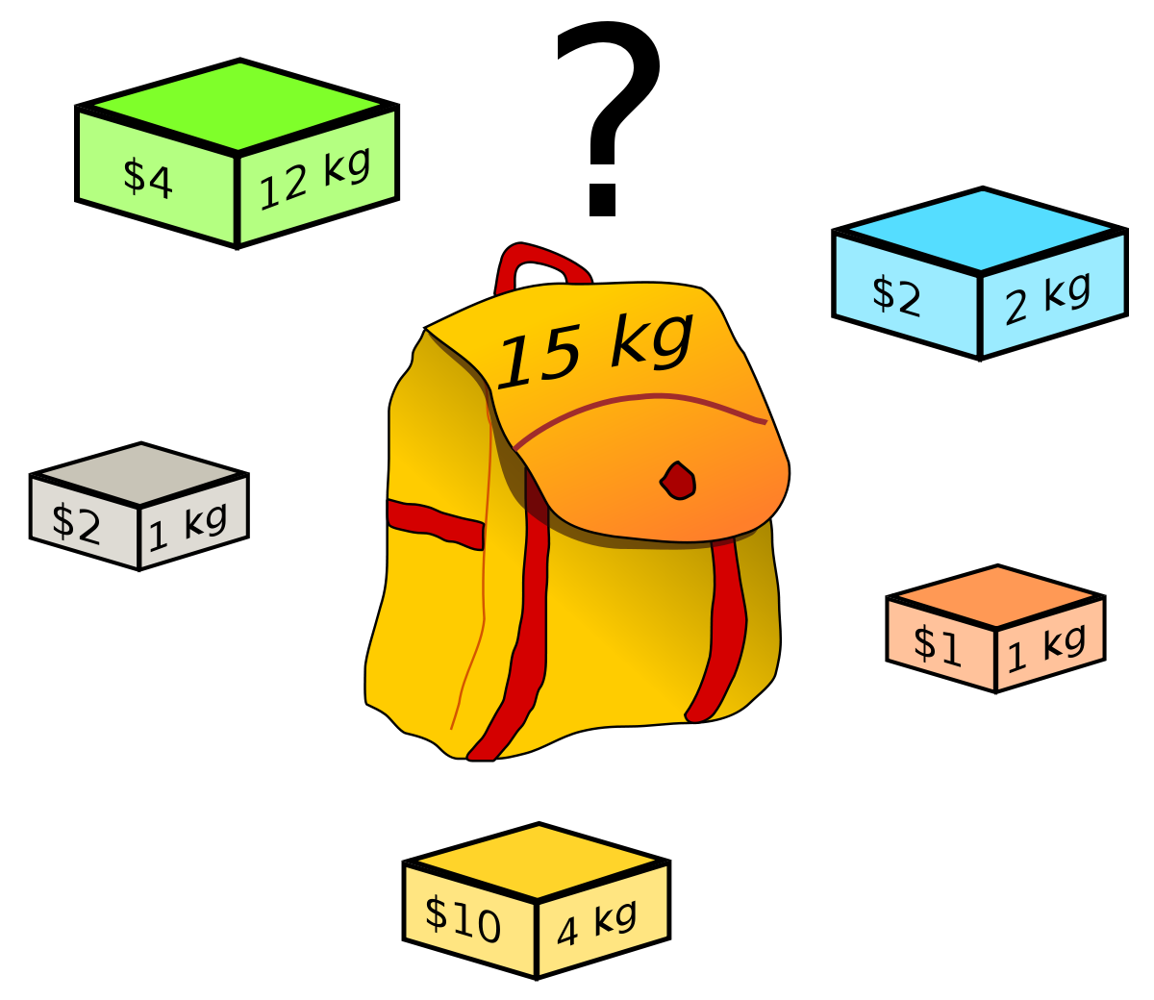
Bin Packing problem

Slide 19
Grooming
While the multiplexing process bundles demands into wavelengths end-to-end, grooming allows re-bundling of lightpaths to occur at intermediate nodes of a connection
Grooming attempts to form well-packed lightpaths between two particular grooming sites as opposed to between the ultimate source and destination of the subrate traffics
Grooming is accomplished through the use of specialized grooming switches, which provide more flexibility and numerous operational advantages as compared to muxponders (sec 6.4)
The switch can automatically repack service demands into wavelengths as traffic patterns change. Furthermore, grooming switches typically have built-in protection mechanisms

Slide 20
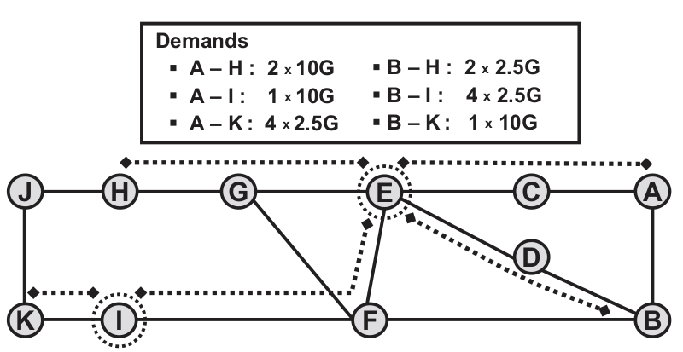
Example of Grooming

Slide 21
Grooming methods head to head

Slide 22
Selecting Grooming Nodes
For economic reasons, most carriers do not deploy a grooming switch in every network node.
The nodes without a grooming switch typically must backhaul their subrate traffic to nearby grooming nodes.
From experience with actual metro-core and backbone networks, selecting about 20–40 % of the nodes to be grooming sites produces designs that are efficient from both a cost and a network-utilization perspective.
Grooming Node Selection Inputs
Physical Topology
Traffic Matrix

Slide 23
Selecting Grooming Nodes (cont.)
Some important factors for selecting grooming nodes (or affects selection process):
A node that generates a lot of subrate traffic is a natural location at which to put a grooming switch. Otherwise, there will be a large amount of traffic to backhaul to other sites, which may be inefficient.
Nodes near the center of the network or nodes that lie along heavily trafficked routes are favored for grooming, as it is likely to be efficient to direct subrate traffic to these sites.
Higher-degree nodes are also good candidates for grooming.
Considering regeneration free path between lightpath endpoints.
Line rate of network
Traffic distribution in network
Available grooming devices (vendor dependent)

Slide 24
Hierarchical Grooming
N
M
A
K
L
B
B
E
J
E
C
D
N
G
K
G
K
F
M
H
I
L

Slide 25
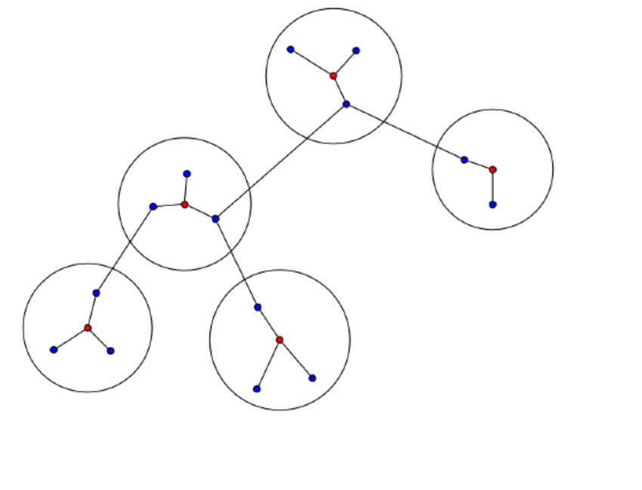
K-Center Problem
Given n cities with specified distances, one wants to build k warehouses in different cities and minimize the maximum distance of a city to a warehouse.
NP-Hard time-complexity
Good for finding gateways in Hierarchical grooming ?

Slide 26
Grooming Trade-offs
The yardstick with which a grooming design is evaluated may depend on the preferences of the carrier or may depend on the circumstances under which the design is being performed.
Cost vs Path Distance
Cost vs Capacity
Cost vs Protection Capacity
Maybe more (carrier specific)

